Slide 1
COMPUTER NETWORK
NETWORKING DEVICES

Slide 2
NIC:
Network Interface Card is also called LAN Card, Ethernet Card, Network Interface Unit (NIU) and Network Adapter. It is networking device that is used to connect two computers in a network using wired or wireless connection. Every NIC has unique 48-bit hexa-decimal address that is called MAC (Media Access Control) Address or Hardware Address.
24-Bit : Vendor ID
24-Bit : Serial No. of Product

Slide 3
MODEM:
Modems are used for data transfer from one computer network to another computer network through telephone lines. The computer network works in digital mode, while analog technology is used for carrying massages across phone lines.
Modulator converts information from digital mode to analog mode at the transmitting end and demodulator converts the same from analog to digital at receiving end. The process of converting analog signals of one computer network into digital signals of another computer network so they can be processed by a receiving computer is referred to as digitizing.

Slide 4
Hub:
A hub is the most basic networking device that connects multiple computers or other network devices together. Unlike a network switch or router, a network hub has no routing tables or intelligence on where to send information and broadcasts all network data across each connection. Most hubs can detect basic network errors such as collisions, but having all information broadcast to multiple ports can be a security risk and cause bottlenecks. In the past, network hubs were popular because they were cheaper than a switch or router.
Today, switches do not cost much more than a hub and are a much better solution for any network.

Slide 5
Switches:
Switch is also a networking device that looks like a hub with multiple ports but it does not work like multiport repeater. It is an intelligent device. A switch in an Ethernet-based LAN reads incoming TCP/IP data packets/frames containing destination information as they pass into one or more input ports. The destination information in the packets is used to determine which output ports will be used to send the data on to its intended destination.

Slide 6
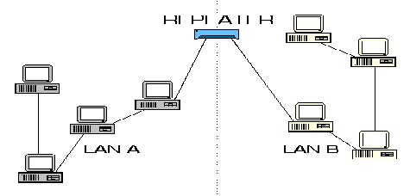
Repeaters:
A network device used to regenerate or replicate a signal. Repeaters are used in transmission systems to regenerate analog or digital signals distorted by transmission loss. A repeater operates at the physical layer. An important point to be noted about repeaters is that they do no amplify the signal. When the signal becomes weak, they copy the signal bit by bit and regenerate it at the original strength. It is a 2-port device.

Slide 7
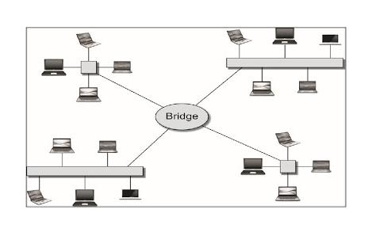
Bridge:
A bridge operates at data link layer. A bridge is a repeater, with add on functionality of filtering content by reading the MAC addresses of source and destination. It is also used for interconnecting two LANs working on the same protocol. It has a single input and single output port, thus making it a 2-port device.

Slide 8
Router:
A router is a device that routes data packets based on their IP addresses. Router is mainly a Network Layer device that connect different network. Routers normally connect LANs and WANs together. A Router also decides best and shortest possible path, if multiple path exist between source and destination.

